Slide 1

A Presentation
On
Automatic Grocery Items Detection and Recognition
Submitted by
Himani Maheshwari(2016546)
Muskan Gangil(2016577)
Samiksha Agarwal(2016601)
Vratika Kataria(2016629)
Supervised by
Dr. Abdullah Bin Queyam
SCHOOL OF AUTOMATION
BANASTHALI VIDYAPITH RAJASTHAN
April 2023

Slide 2

Presentation Outlines
Introduction
Problem Description
Working Algorithm
Working Layout
Solution Methodology
Results & Discussions
Conclusion

Slide 3
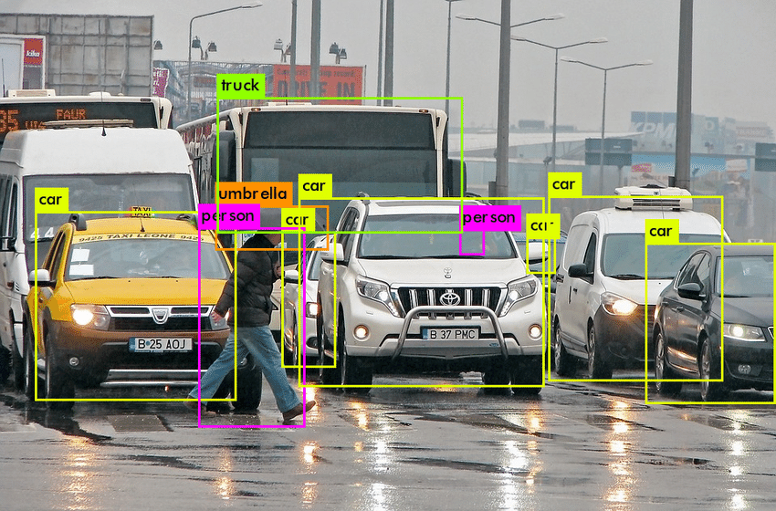

Introduction
Object detection is a computer vision task that requires object(s) to be detected, localized and classified.
The main aim of the project is to detect all instances of objects from a known class, such as people, grocery items, cars or faces in an image.

Slide 4
Basic Functions of object detection:
Video Input: It can be a stored video or a real time video.
Pre-processing: It mainly involves temporal and spatial smoothing such as intensity adjustment, removal of noise.
Object detection: It is the process of change detection and extracts appropriate change for further analysis and qualification.
Post-processing: - Remove false detection caused due to dynamic conditions in the background using morphological and speckle noise removal.
Video Input
Pre-processing
Object Detection
Post-processing

Slide 5
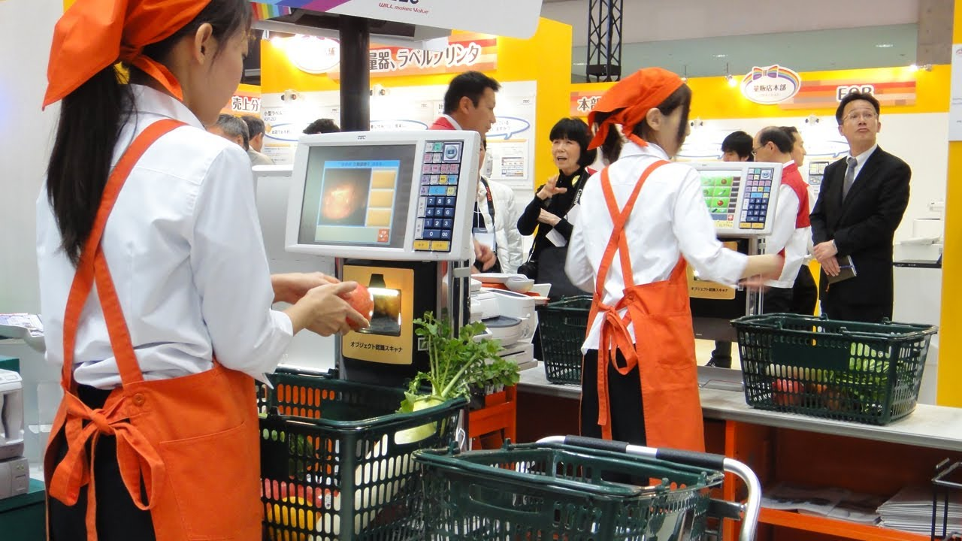
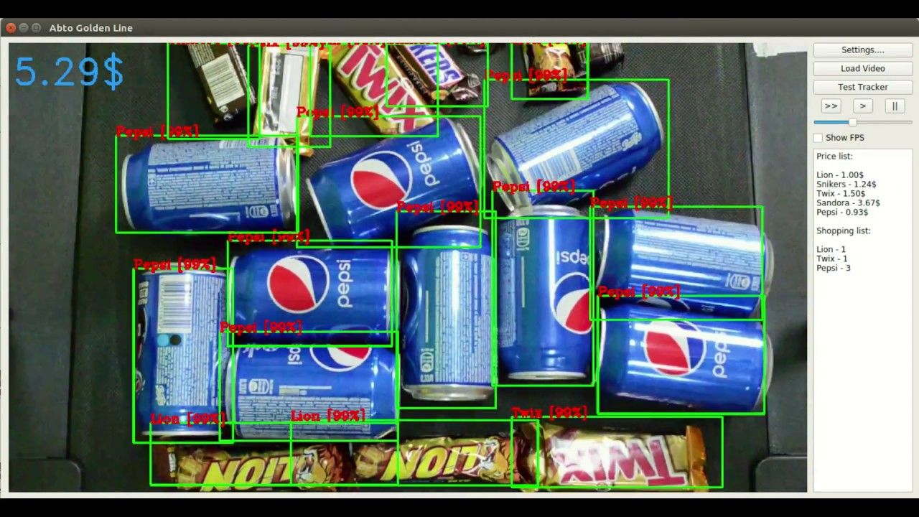
Problem Description
In the modern era, the people have more income to spend and lesser time to spare, so they generally choose supermarkets for grocery and other shopping rather than local shops.
The customer is free to choose products from huge available varieties which attract the large customers mainly in big cities so long queues of customers are seen at these stores.

Slide 6
Working Algorithm
Start
Capturing real time video
Extracting features
Searching in the database
NO
YES
No similar product found!
Draw box around the matched object and extract its name in excel sheet along with its price
End

Slide 7
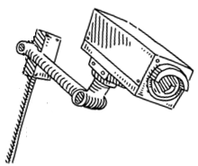


Working Layout
Camera
Automatic item detection and bill generation
2.
USB Cable
3.
MATLAB
---------------- Rs. 400
---------------- Rs. 200
----------------Rs. 100
----------------------------------------------------------------
Total: Rs. 700/-
1.
Grocery Items
Laptop with MATLAB

Slide 8
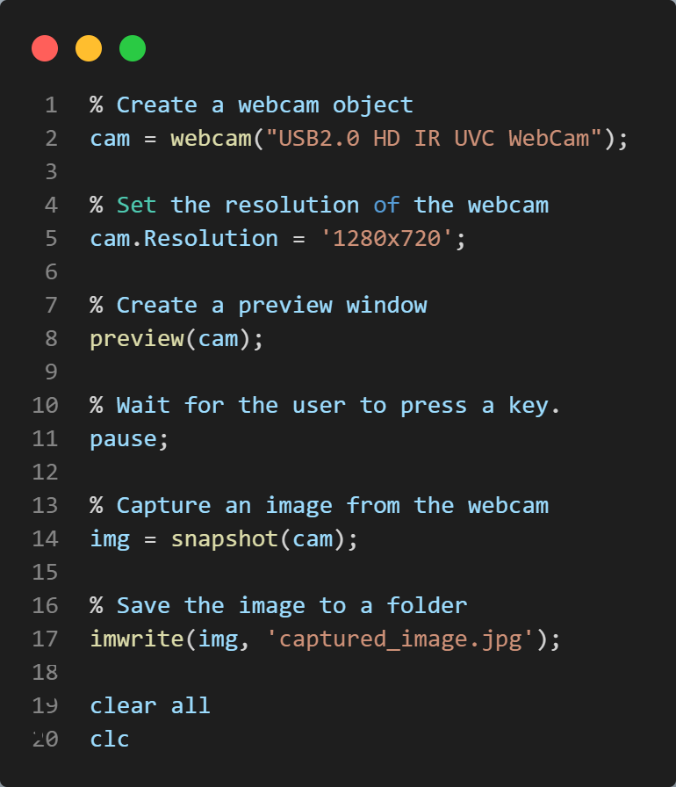
Solution Methodology
In this work, we presented a review study on object detection. We have surveyed about different object detection techniques. This survey provides theoretical knowledge about different object detection approaches.
How to Capture an Image:

Slide 9
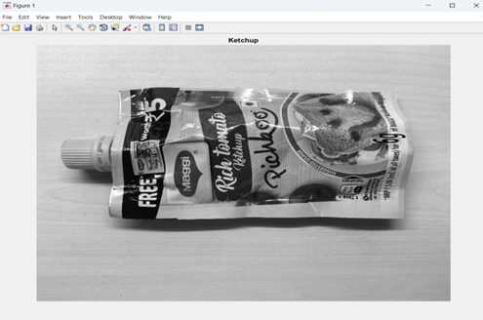
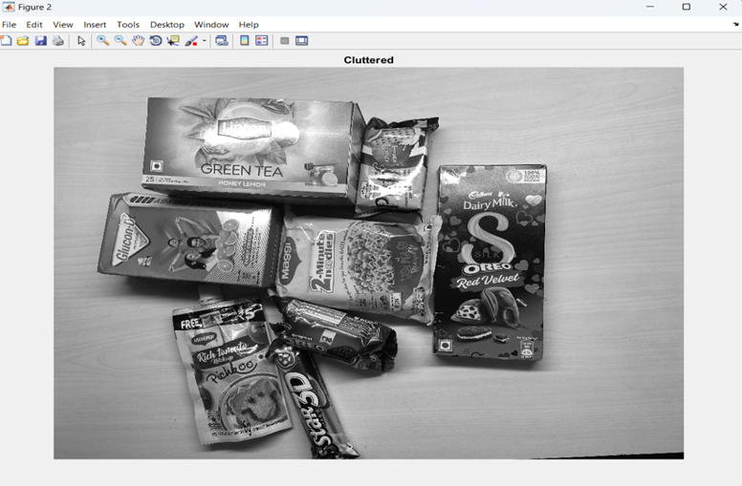
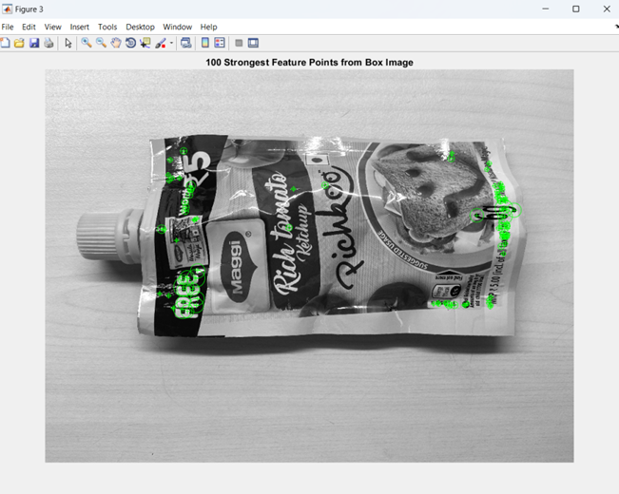
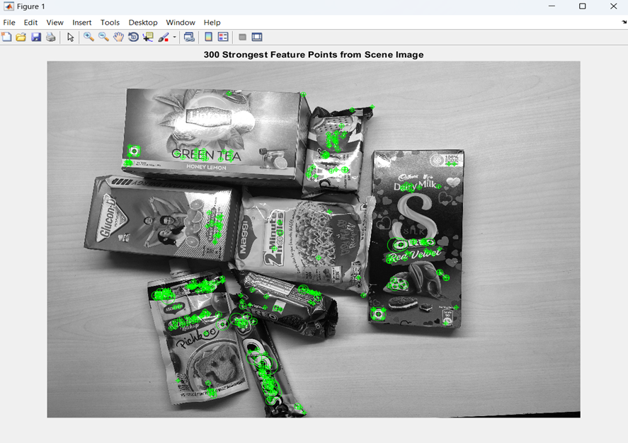
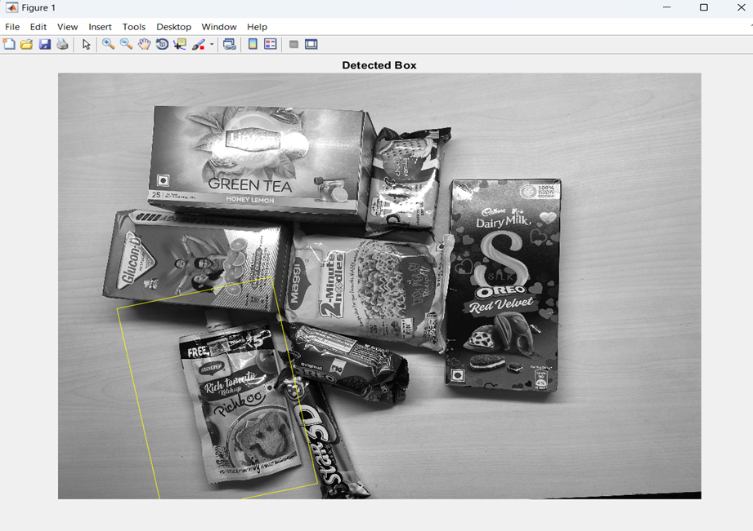
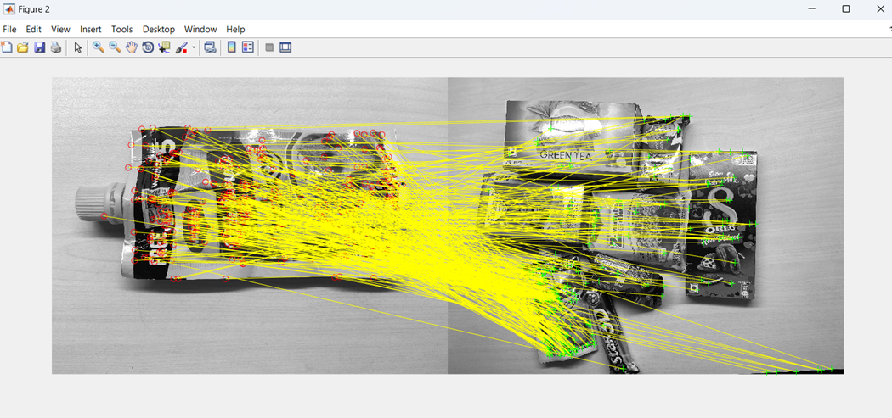
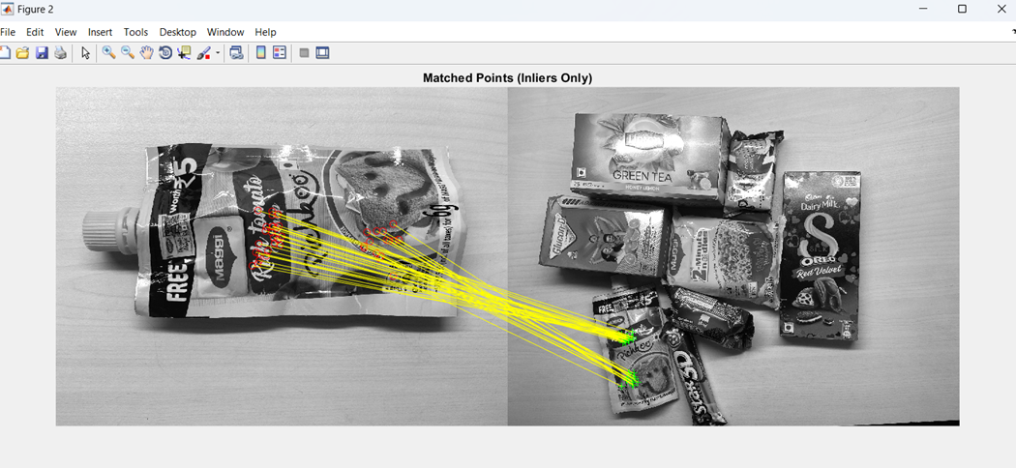
Object Detection for cluttered image

Slide 10
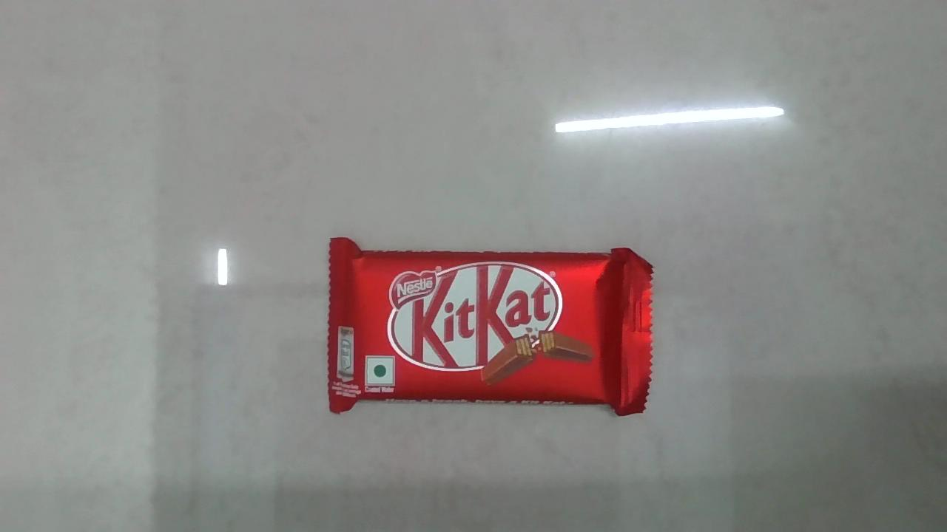
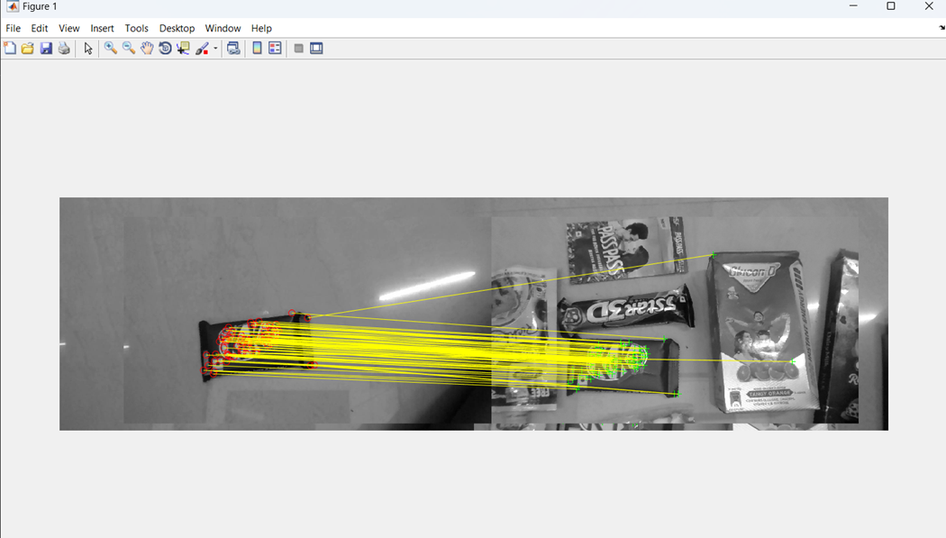
Object detection in real time video

Slide 11
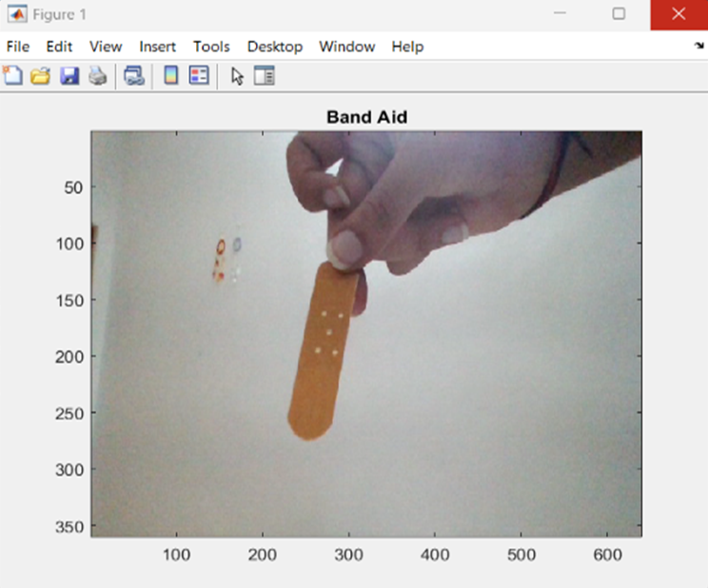
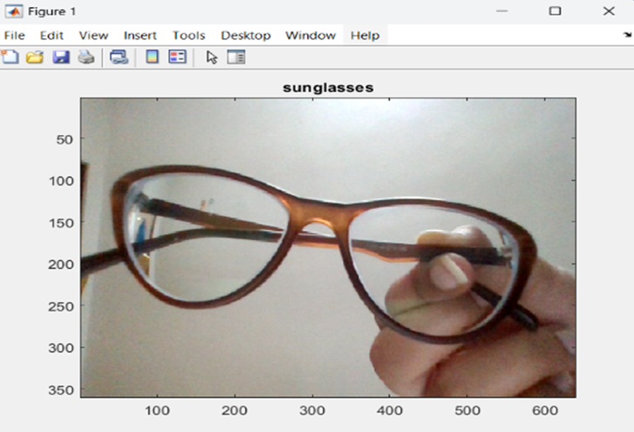
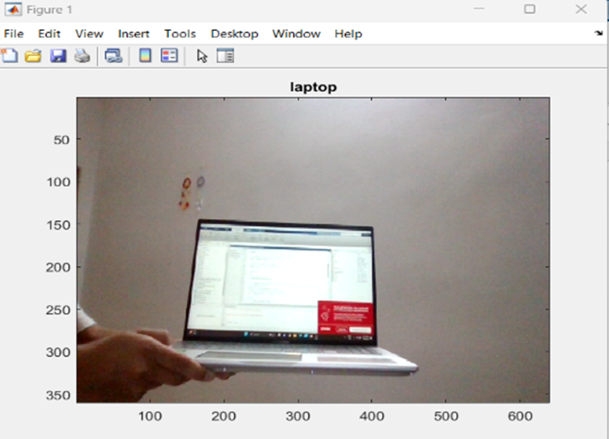
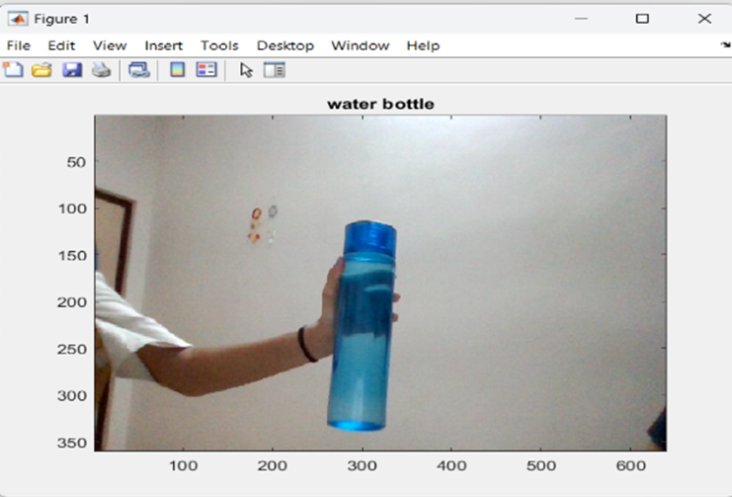
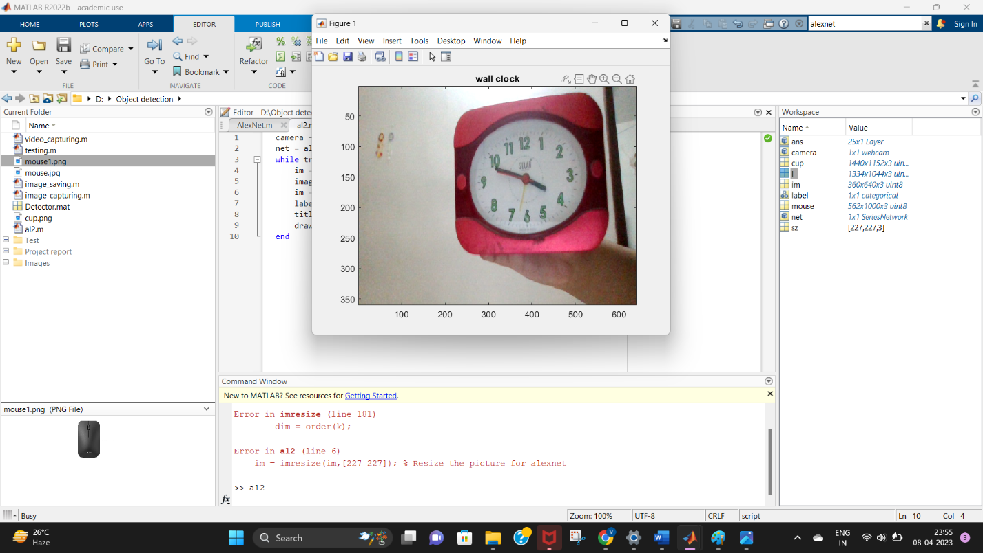
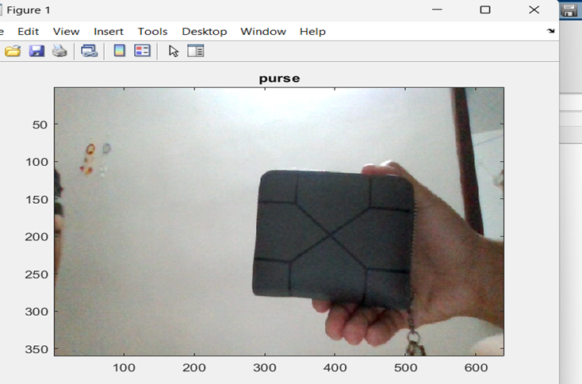
OBJECT DETECTION USING ALEXNET

Slide 12
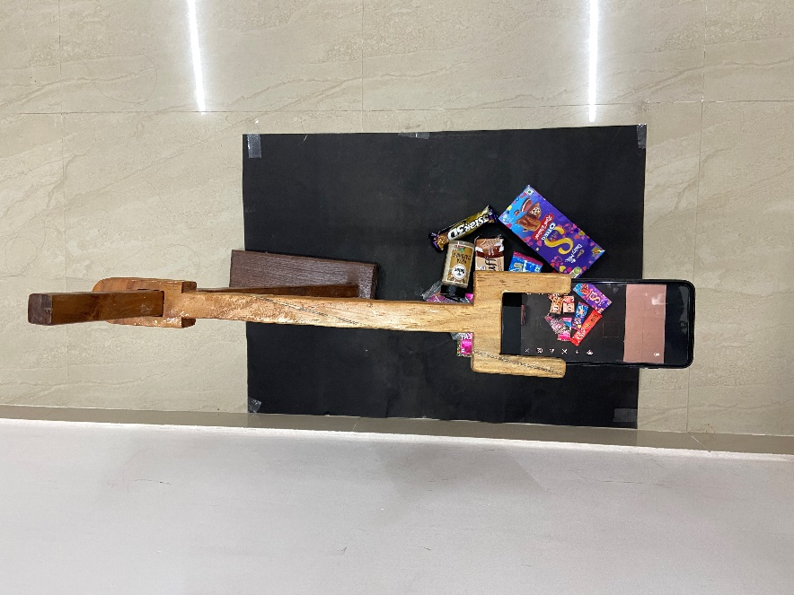
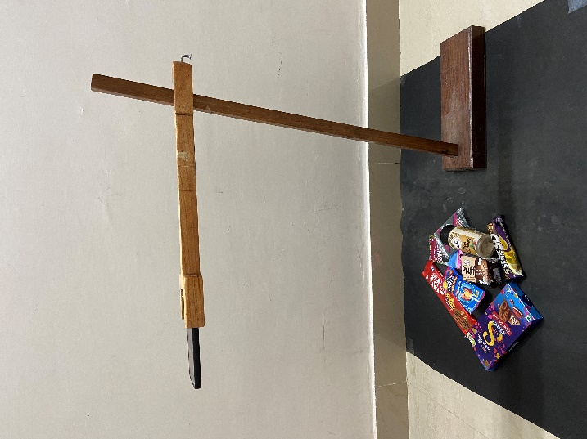
Results & Discussions
In this work, we presented a review study on object detection. We have surveyed about different object detection techniques. This survey provides theoretical knowledge about different object detection approaches. Based on this study, Feature extraction using SURF has been found to be effective and is used for the detection and recognition of the glossary items.
A few glimpses of what the setup looks like:

Slide 13
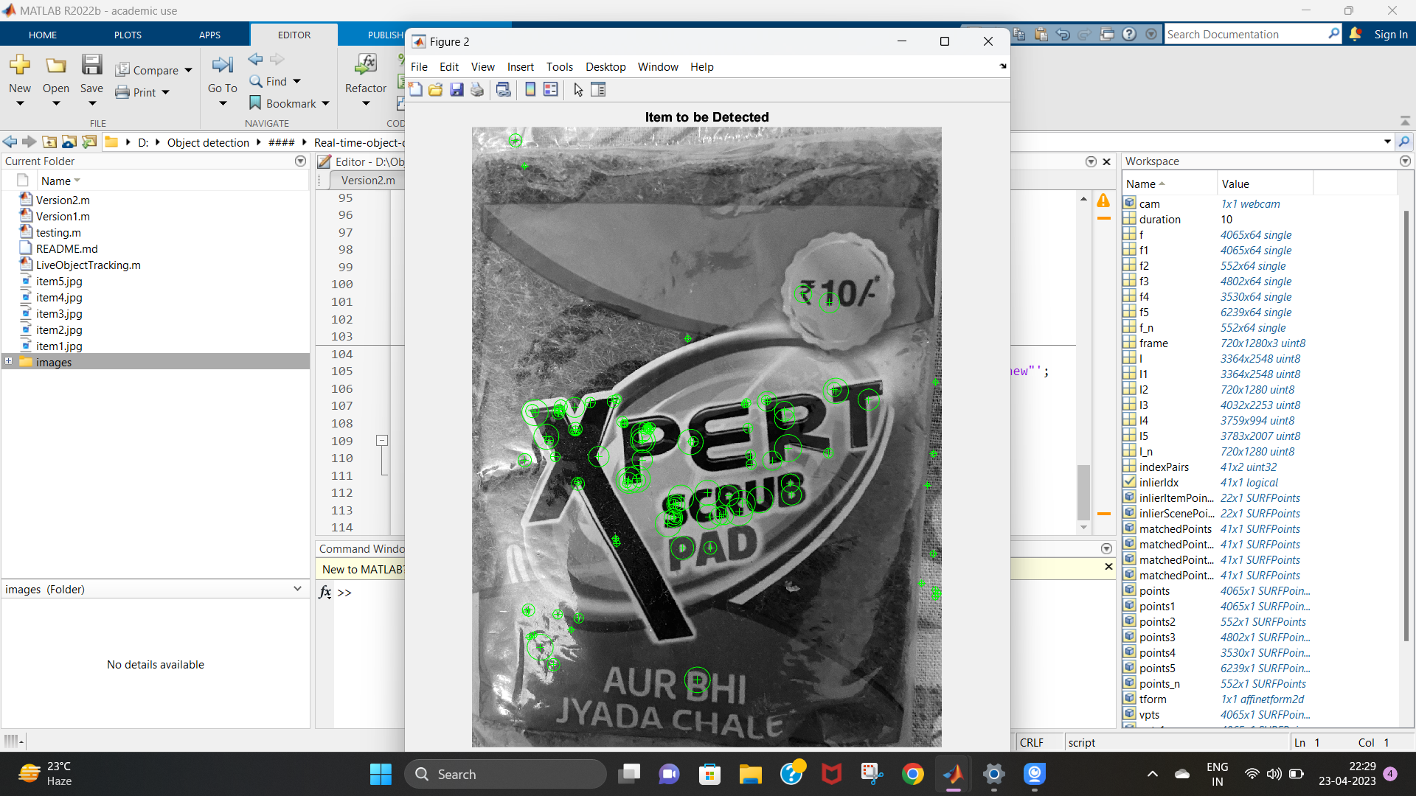
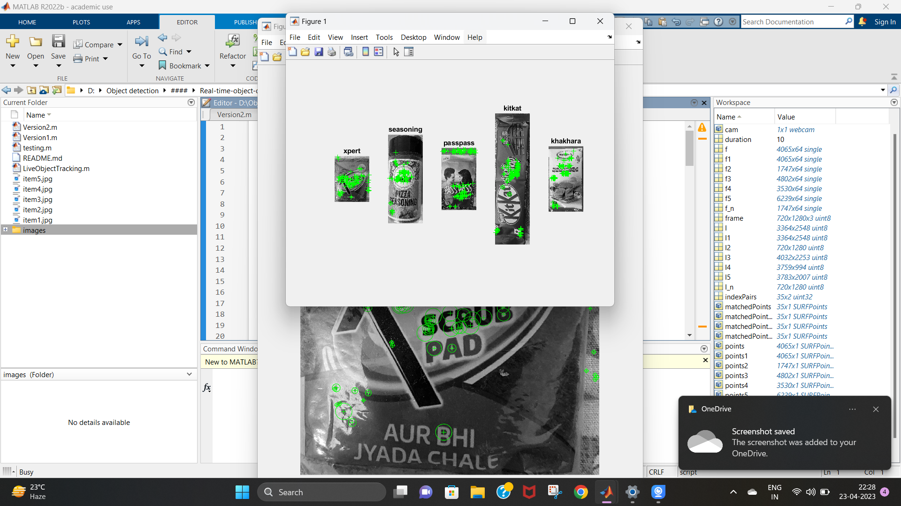
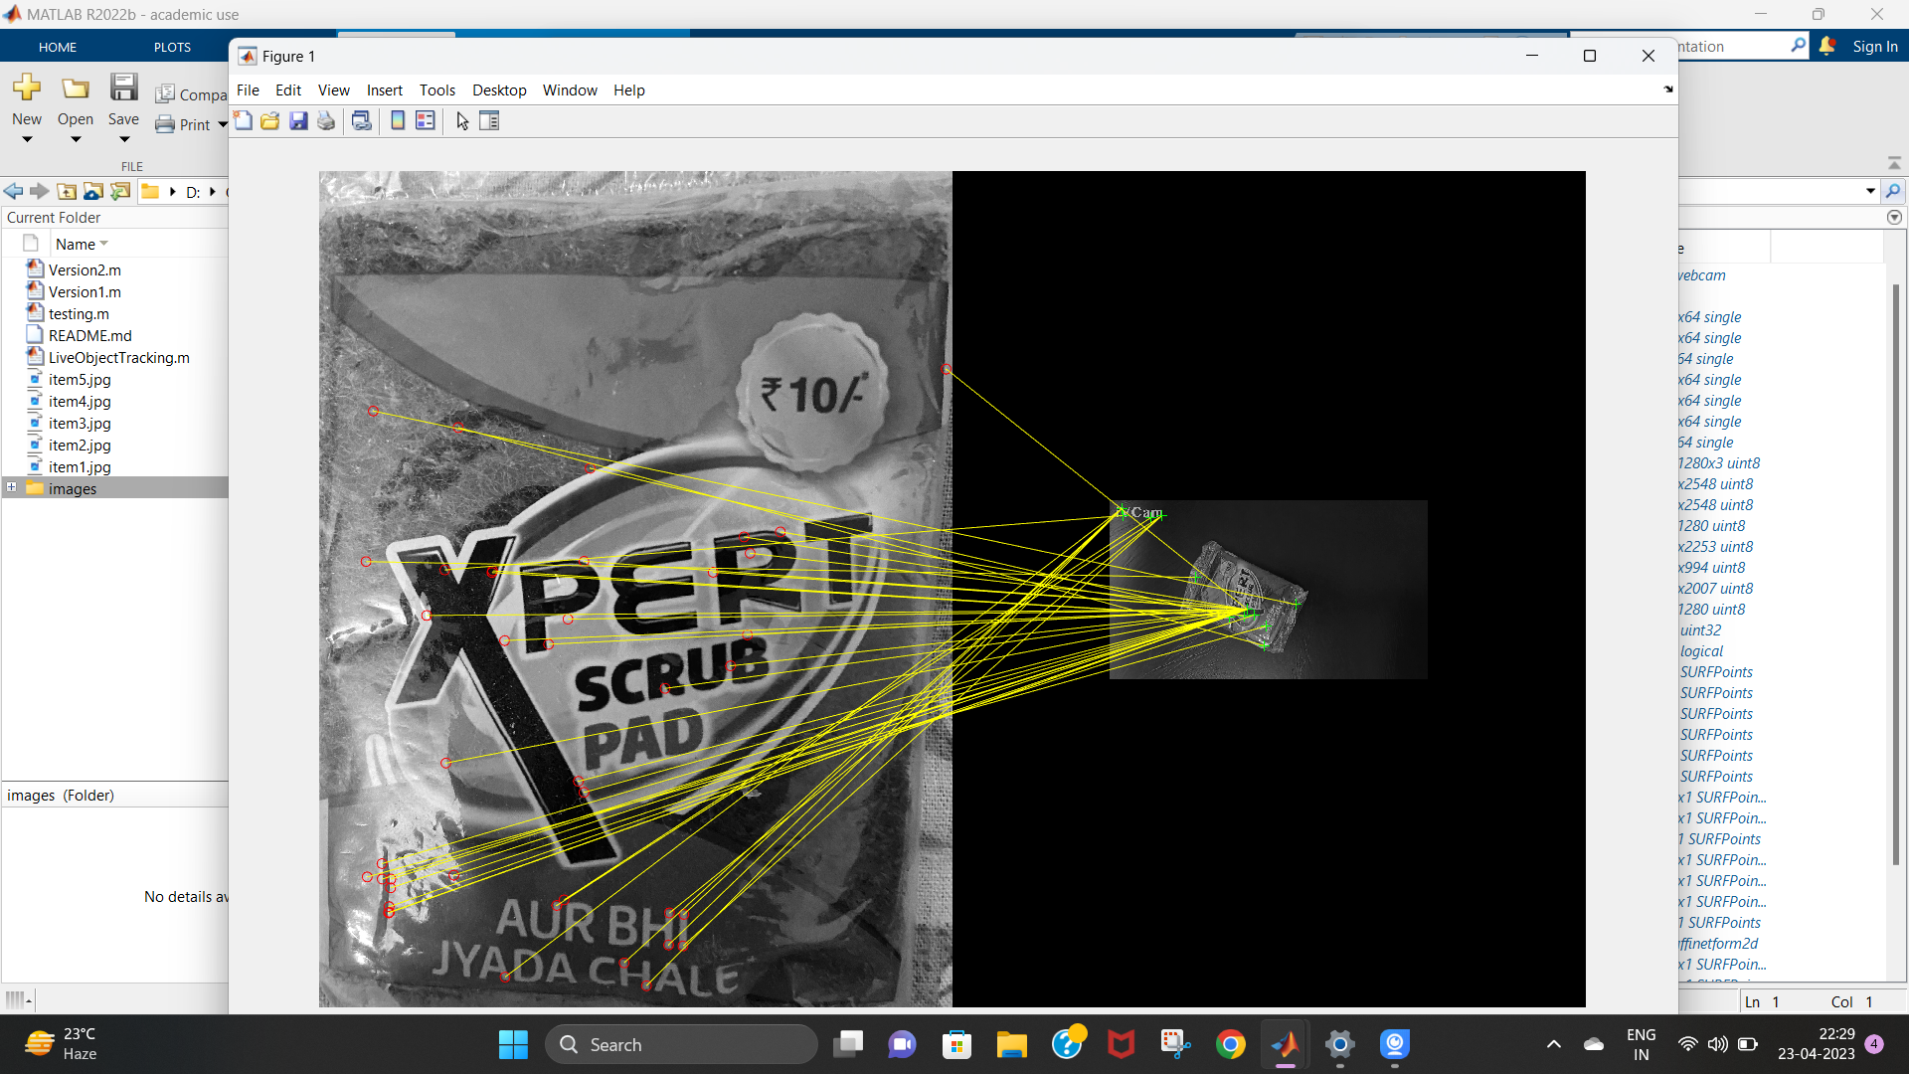
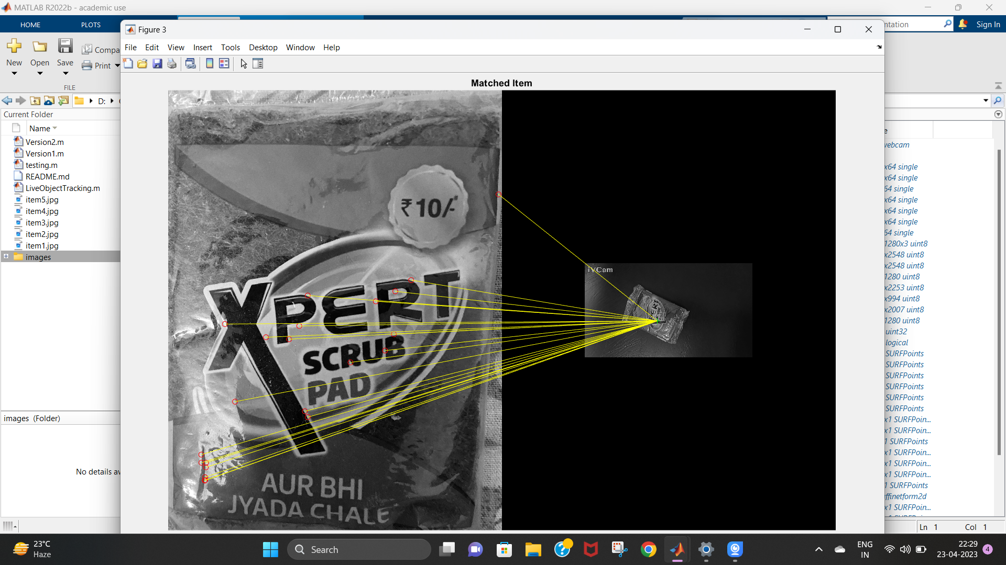
How objects were detected:

Slide 14
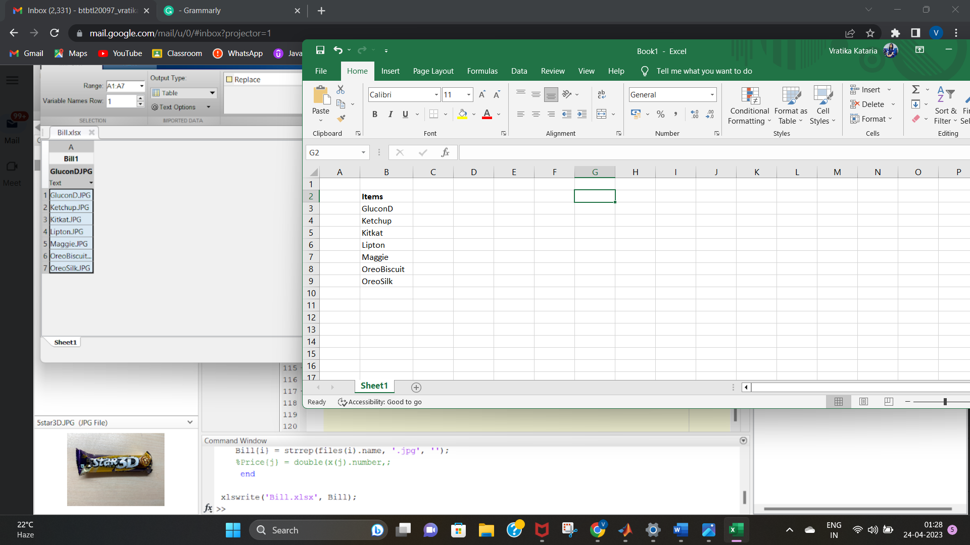

A look at the Excel sheets:

Slide 15
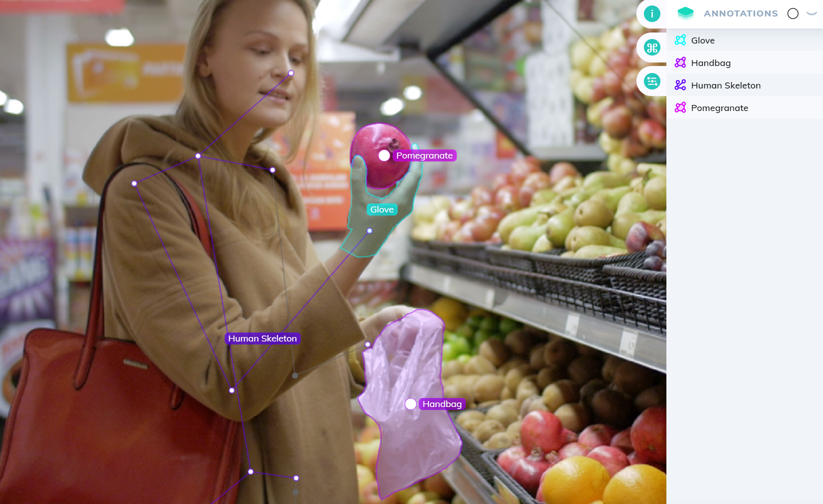
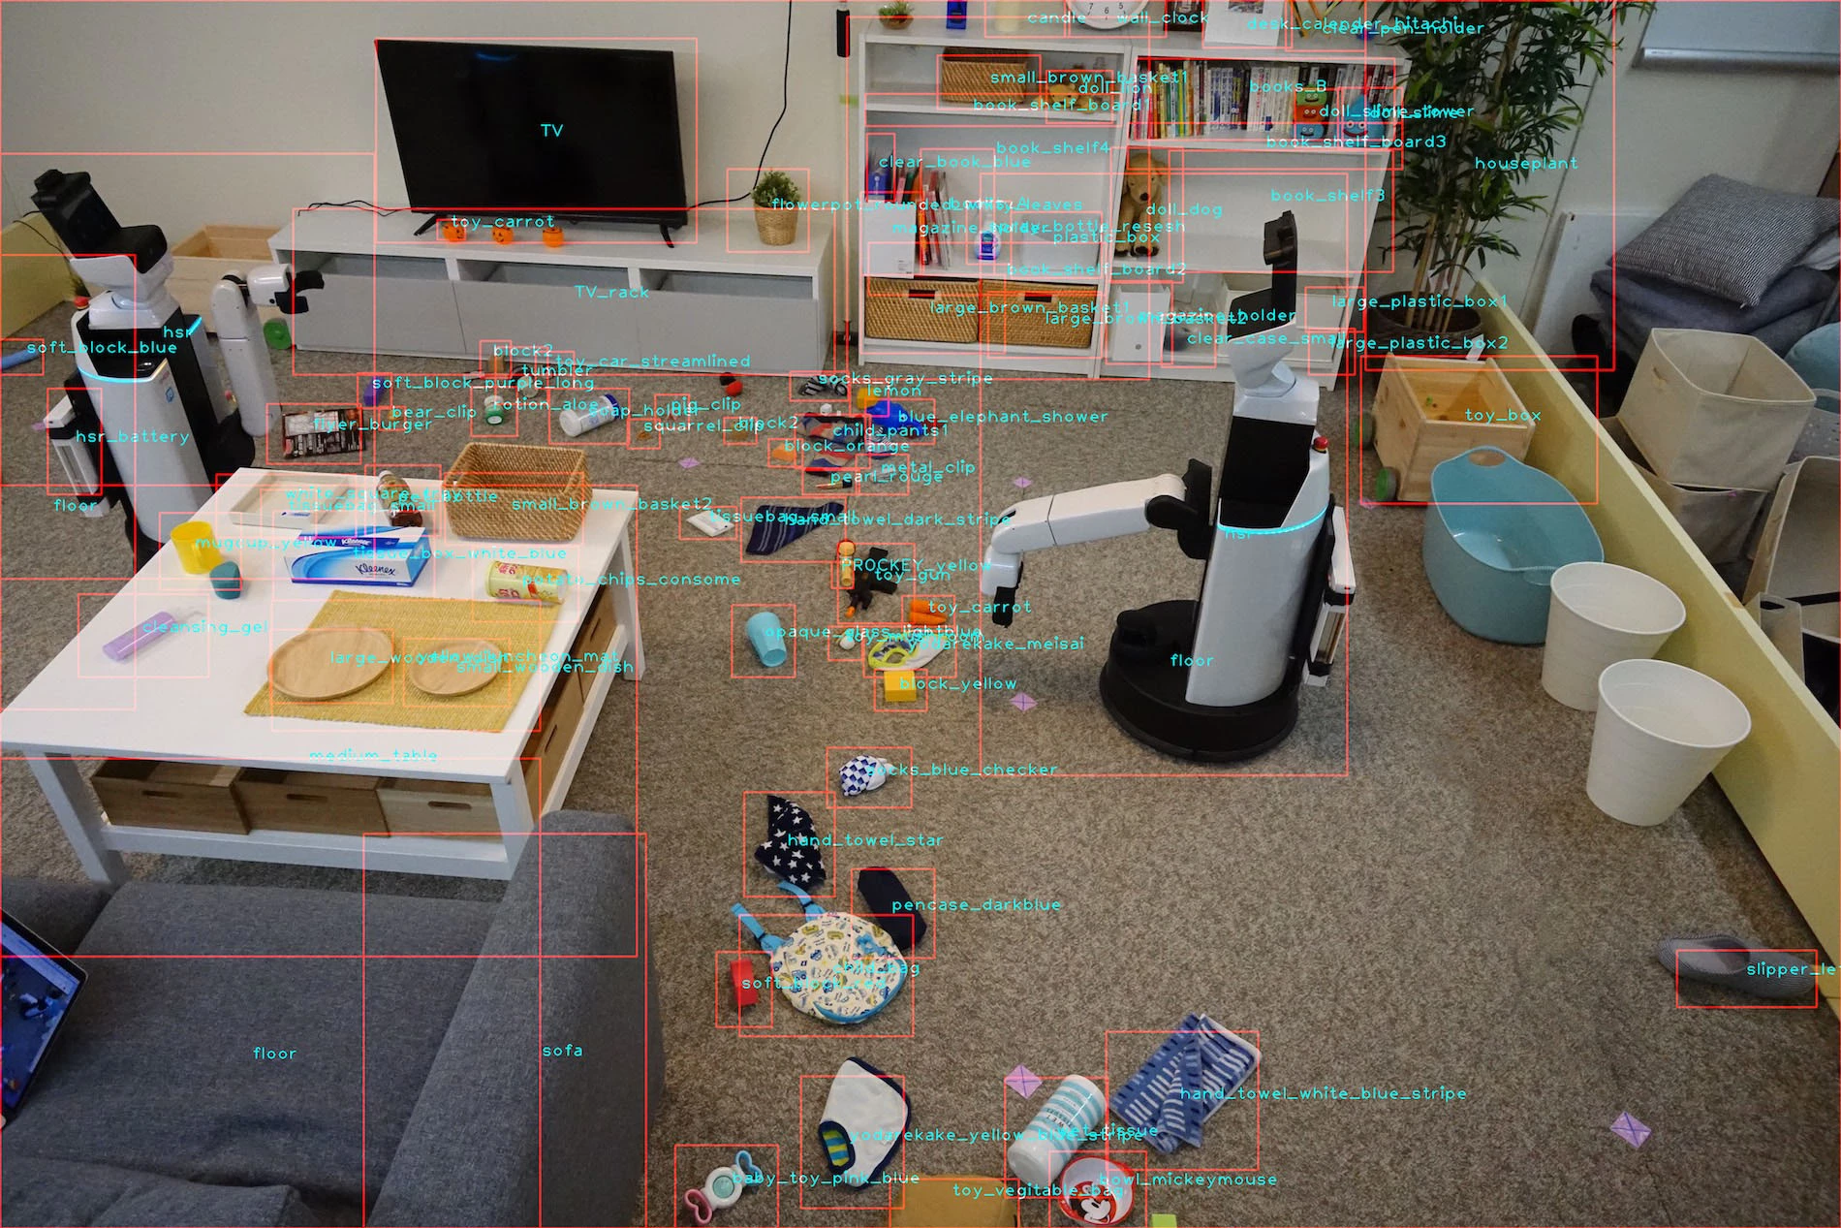
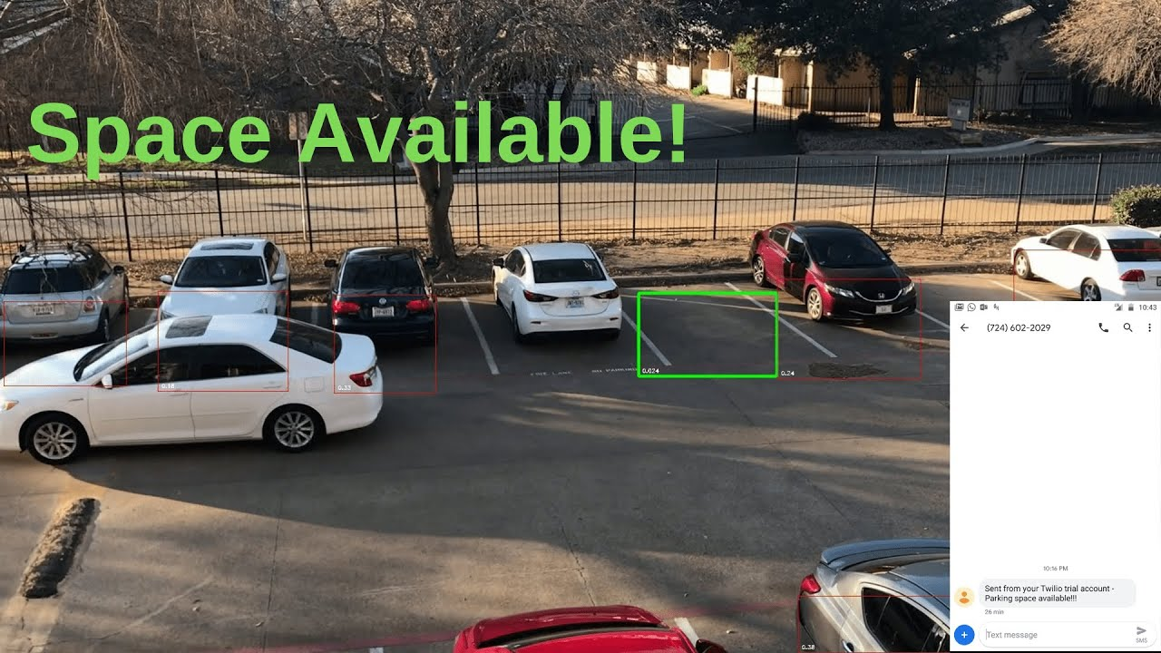
Conclusion
The progression in science & technology development is an unstoppable process. Now & then evolution changing technologies are being invented. We can’t imagine the upcoming future in which technology may occupy each & every place. This innovative project idea can be used is places like shopping complexes, supermarkets & malls to purchase the products.

Slide 16
References
https://www.fritz.ai/object-detection/#:~:text=Object%20detection%20is%20a%20computer,all%20while%20accurately%20labeling%20them.
https://in.mathworks.com/discovery/object-detection.html
https://machinelearningmastery.com/object-recognition-with-deep-learning/
https://towardsdatascience.com/object-detection-with-10-lines-of-code-d6cb4d86f606
https://developers.google.com/ml-kit/vision/object-detection
https://www.v7labs.com/blog/object-detection-guide

Slide 17
Thank you!

